Slide 1
CIS 115 Quick Review and Quick Start
Chapters 3 and 4

Slide 2
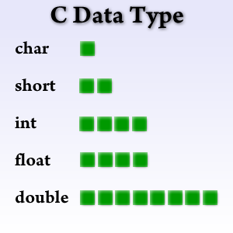
After naming the item in an IPO chart, a(n) __________ must be chosen.

Slide 3
After naming the item in an IPO chart, a(n) Datatype must be chosen.

Slide 4


In C++, the two types of memory locations available for you to temporarily store data are __________ and __________ __________.

Slide 5
In C++, the two types of memory locations available for you to temporarily store data are variables and named constants.

Slide 6
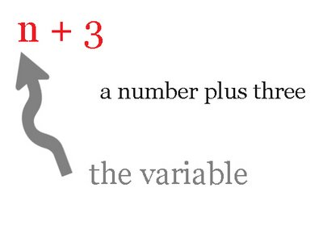
The value of a(n) __________ is permitted to change during the execution of a program.

Slide 7
The value of a(n) variable is permitted to change during the execution of a program.

Slide 8

A(n) __________ is also known as a reserved word.

Slide 9
A(n) keyword is also known as a reserved word.

Slide 10

The last rule in naming identifiers/variables in C++ is that all identifiers/variables are case __________.

Slide 11
The last rule in naming identifiers/variables in C++ is that all identifiers/variables are case sensitive.

Slide 12

The string data type is not one of the __________ data types in C++.

Slide 13
The string data type is not one of the fundamental data types in C++.

Slide 14

Numbers are represented in internal memory using the __________ number system.

Slide 15
Numbers are represented in internal memory using the binary number system.

Slide 16

Variables of type __________ can take on the values of true and false.

Slide 17
Variables of type Boolean datatype can take on the values of true and false.

Slide 18

The float and double data types store __________ numbers.

Slide 19
The float and double data types store real numbers.

Slide 20

Unlike variables and named constants, __________ constants are not memory locations.

Slide 21
Unlike variables and named constants, literal constants are not memory locations.

Slide 22

A string literal constant is zero or more characters enclosed in __________ quotation marks.

Slide 23
A string literal constant is zero or more characters enclosed in _double quotation marks.

Slide 24

A character literal constant is a single character enclosed in __________ quotation marks.

Slide 25
A character literal constant is a single character enclosed in single quotation marks.

Slide 26

The __________ keyword is used to indicate that a memory location is a named constant.

Slide 27
The constant keyword is used to indicate that a memory location is a named constant.

Slide 28

All statements in C++ must end with a(n) __________.

Slide 29
All statements in C++ must end with a(n) _semicolon.

Slide 30
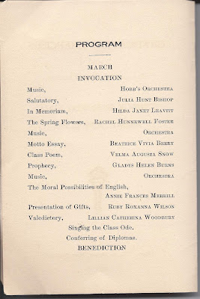
Chapter 4
Still in the 4th step of the problem-solving process.
What is the 4th step?

Slide 31
Answer: Coding

Slide 32
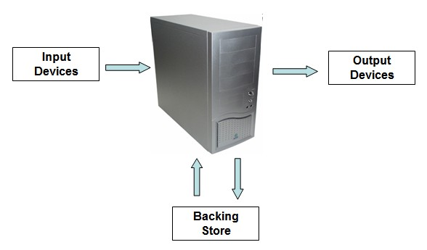
Input and Output Statements
What they are and how they work.

Slide 33
Input and Output Statements Answer
Input statements bring data from the screen into the program.
Output statements send data from the program to the screen.

Slide 34

Objects Perform …
Input and Output Operations
Called Stream Objects
A stream is a sequence of characters

Slide 35
What is an Object?

Slide 36
Answer: What is an Object?
Performs standard input and output operations

Slide 37
Why are they called stream objects?

Slide 38

Answer: Why are they called stream objects?
They handle streams of characters.

Slide 39
What is a stream?

Slide 40




Answer: What is a stream?
A sequence of characters.

Slide 41
More About Objects
Created by a Class
Resides in a special area of the computer’s internal memory
A class is simply a group of instructions used to create an object

Slide 42
How are Objects Created?

Slide 43
Answer: How are Objects Created?
By a class

Slide 44
What is a class?

Slide 45

Answer: What is a class?
A group of instructions used to create an object.

Slide 46
cin
Gets information into the program
Used with an extraction operator
>>
Allows the user to communicate with the program while it is running

Slide 47
When does the extraction stop?
When the cin object encounters a white-space character.
A white-space character:
Newline (Enter)
Tab
Spacebar key (blank)

Slide 48

What is the extraction operator?

Slide 49
Answer: What is the extraction operator?
>>

Slide 50
How is a white-space character created?

Slide 51
Answer: How is a white-space character created?
Newline (Enter)
Tab
Spacebar (blank character)

Slide 52
Examples
cin >> item;
cin >> salary;
cin >> number;
cin >> letter;

Slide 53
What happens after the cin statement?
The computer waits for the user to enter something on the screen.
The cursor just sits and blinks until something is entered.
The program is on “pause”.

Slide 54
But…
We can’t just say cin >>
Because the user will only see a blinking cursor

Slide 55
We need a Prompt
A message that tells the user what to enter.

Slide 56
cout
Used with an insertion operator
<<
Displays information on the screen
To “send out” information to the user

Slide 57
When do you use cin?

Slide 58
Answer: When do you use cin?
To get information into the program from a user.

Slide 59
When do you use cout?

Slide 60

Answer: When do you use cout?
To send information from the program to the screen.

Slide 61
Stream Manipulator
Allows you to manage the characters in the input or output stream
We will use endl with cout
endl moves the cursor to the next line

Slide 62
COUT Examples
cout << salary;
cout << number;
cout << amount << endl;
cout << “This is your salary ” << salary;
cout << “This is your number ” << number;
cout << “This is the amount “ << amount << endl;

Slide 63

What does the insertion operator look like?

Slide 64
What does the insertion operator look like? Answer:
<<

Slide 65
What does the extraction operator look like?

Slide 66
What does the extraction operator look like? Answer
>>

Slide 67
//
Used for comments
All good programmers use comments
//declare variables
//calculate the total
//display the output
//program name, purpose, date

Slide 68

IDE
Integrated Development Environment
Visual Studio 2019

